Slide 1
Chapter 7
— 例题与作业

Slide 2
计算题类型
根据资源、进程间的请求关系，画出Resource-Allocation Graph
根据资源分配图分析死锁出现的资源条件，或避免死锁的资源条件
Deadlock Avoidance
当每类资源只有一个资源实例，利用Resource-Allocation Graph Algorithm判断有无死锁/系统是否安全
当资源可有多个资源实例时，利用Banker Algorithm判断系统是否安全?(无死锁?), 进程的资源请求是否be granted
Deadlock Detecting
当每类资源只有一个资源实例，利用waiting graph判断有无死锁?
当资源可有多个资源实例时，利用deadlock detecting algorithm 判断有死锁?

Slide 3
Examples
Resource Allocation Graph/Cycle and Deadlock
例1. 道路交通与资源分配状态
例2. 导致死锁发生的最大资源数/保证死锁不发生的最少资源数
例3. Fig. 7.3, Fig. 7.4
例4. 408选择题：发生死锁的最少进程数
Banker’s Algorithm
例5. /补充作业1
例6.
Deadlock Detection
例7.
补充作业2
7.5, 7.7, 7.11
补充作业1、2

Slide 4
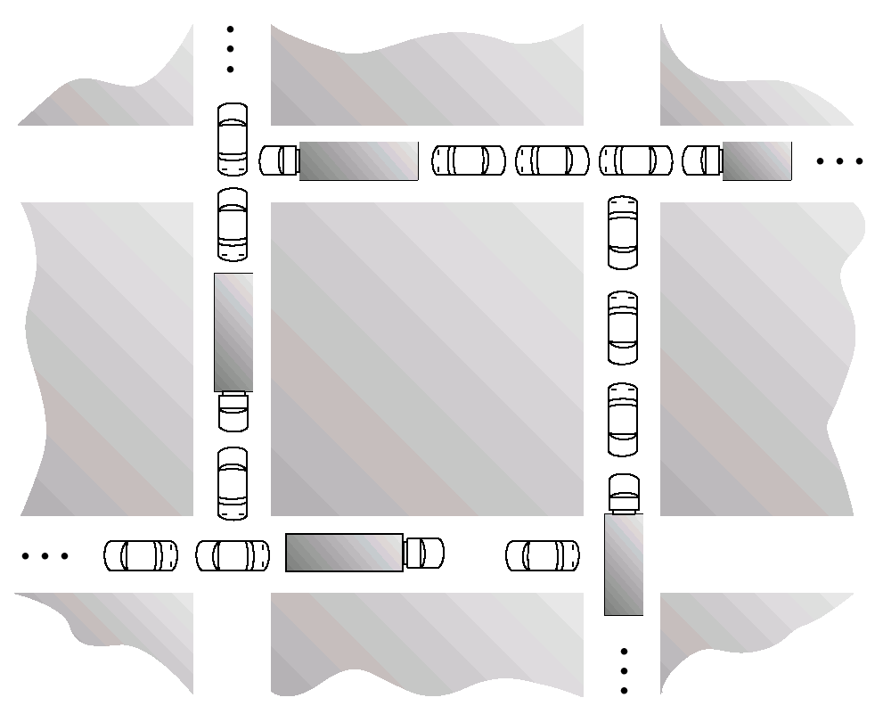
例1. 道路交通与资源分配状态
Traffic Deadlock for Exercise 7.4

Slide 5
例1. 道路交通与资源分配状态
利用进程-资源模型描述 Fig.7.9
进程—汽车，资源—道路，
进程执行——汽车前进
资源单位—道路长度,
资源实例—一个单位长度的道路
进程执行（由k时刻进展至k+1时刻）：车辆前行一个单位长度
道路：4个路口A，B，C，D，长度为一个单位（对应一个资源实例）
路口间4条直道：长度为4个单位，对应4个资源实例
小车：长度为1，每前进一步需要使用2个道路资源实例，然后再释放一个道路资源实例
大车：长度为2，每前进一步需要使用3个道路资源实例，然后再释放一个道路资源实例
Available, Allocation, Need, MAX, by means of Banker algorithm

Slide 6
Example 2 Resources and Deadlock
01
某系统有K台互斥使用的同类设备，n=3个并发进程分别需要使用2、3、4台设备，可确保系统发生死锁的最大设备数目K为多少?
答案
资源种类数m=1，K个资源实例
导致发生死锁的
K = 所有进程的设备资源总需求L — 进程总数n
= (2 + 3 + 4) – 3 = 6
确保不发生死锁的最少资源实例总数为：
K+1 = 所有进程的设备资源总需求L — （进程总数n-1）
= (2 + 3 + 4) – （3-2） = 7

Slide 7
Example 2 Resources and Deadlock
01
L=9，K=9， n=3个进程的设备需求完全满足，进程无等待

Slide 8
L=9，K=6， n=3个进程的需求不满足，每个进程缺少1个资源，形成循环等待
01

Slide 9
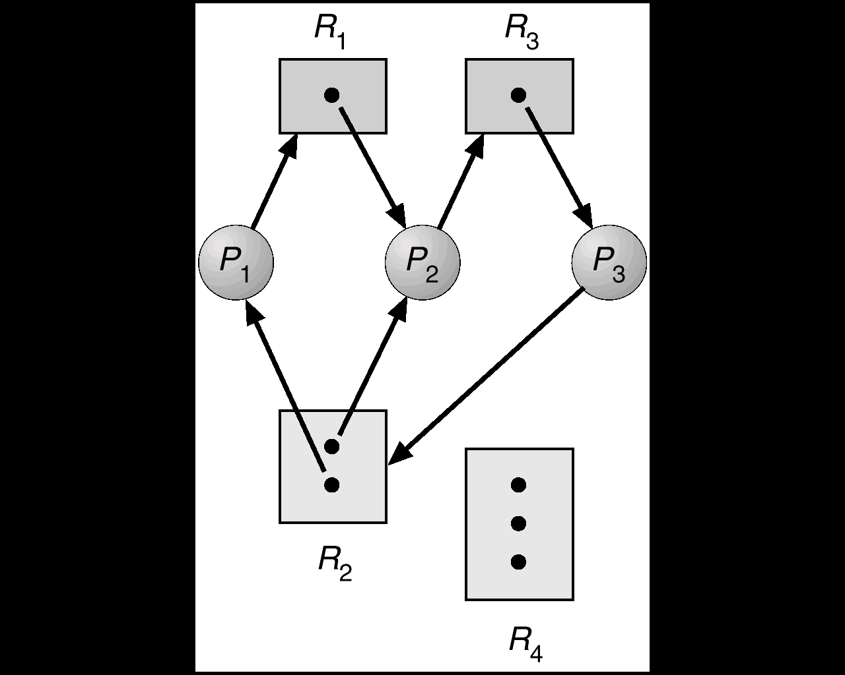
例3. Fig. 7.3
01
Fig. 7.3
进程数目n=3
有访问需求的资源总类m=3，
R1, R2, R3的资源实例总数
=(1+ 2 +1)=4
3个进程对资源的总需求
L=(2 + 3 + 2) = 7
K= L- n=7-3=4
, 等于目前资源实例总数，发生死锁
有环路、有死锁
waiting
*
F.g.7.3

Slide 10
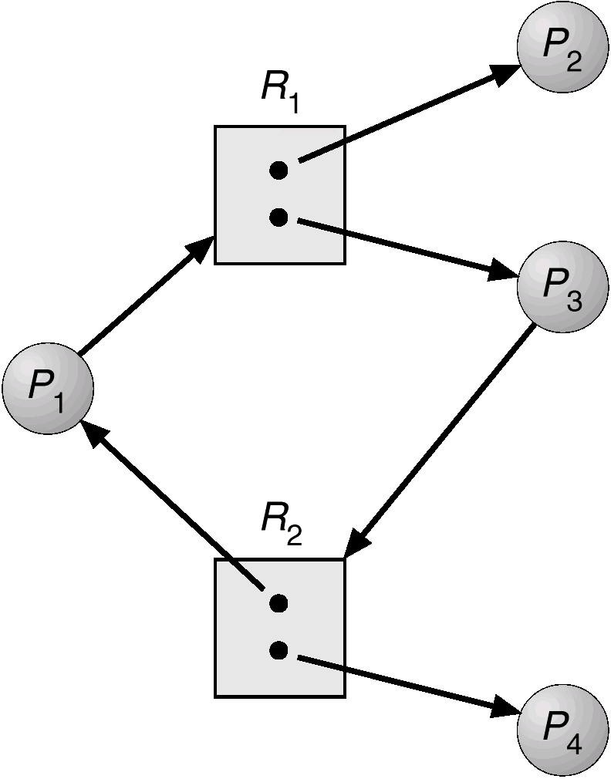
例3. Fig. 7.4
01
Fig. 7.4
进程数目n=4
资源总类m=2
2类资源的实例总数
=(2+ 2 )=4
4个进程对资源的总需求L
L=(2 + 1 + 2 + 1)=6
导致发生死锁的
K= L- n=6-4=2
目前，2类资源的实例总数 4 >= K+1=3，
无死锁
P2、P4没有处于环路中
有环路、无死锁
running
waiting
waiting
Fig.7.4
running

Slide 11
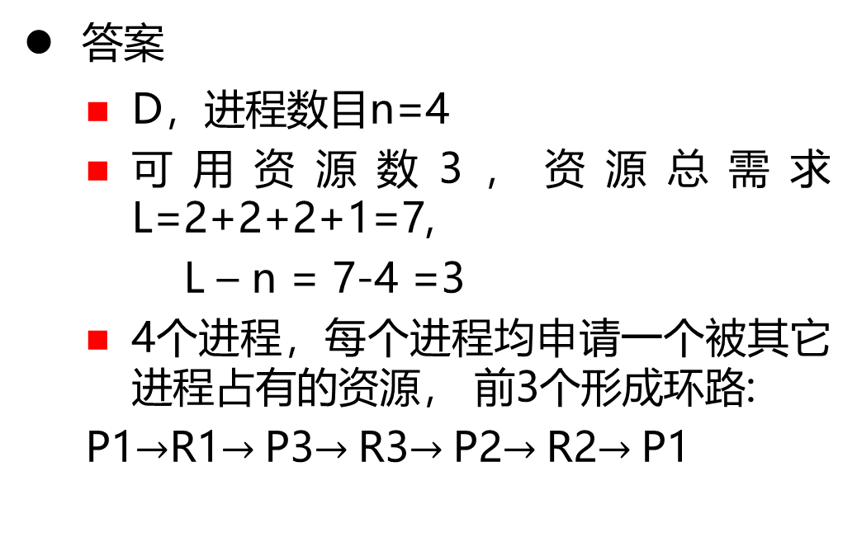
例4. 408选择题
01
25．系统中有3个不同的临界资源R1、R2和R3，被4个进程P1、P2、P3及P4共享。各进程对资源的需求为：P1申请R1和R2，P2申请R2和R3，P3申请R1和R3，P4申请R2。若系统出现死锁，则处于死锁状态的进程数至少是
A．1 B．2 C．3 D．4
P1
答案
D，进程数目n=4
可用资源数3，资源总需求L=2+2+2+1=7,
L – n = 7-4 =3
4个进程，每个进程均申请一个被其它进程占有的资源， 前3个形成环路:
P1$→$R1$→$P3$→$R3$→$P2$→$R2$→$P1
R1
P2
R2
P3
R3
P4

Slide 12
例5. Banker’s Algorithm
01
There are 5 processes P₀ , P₁, P₂, P₃, P₄; 3 resource types A with 10 instances (e.g. memory), B with 5 instances (disk), and C with 7 instances (tapes)
snapshot at time T₀:
Allocation Max Available Need=MAX —Allocation
A B C A B C A B C A B C
P₀ 0 1 0 7 5 3 3 3 2 7 4 3
P₁ 2 0 0 3 2 2 1 2 2
P₂ 3 0 2 9 0 2 6 0 0
P₃ 2 1 1 2 2 2 0 1 1
P₄ 0 0 2 4 3 3 4 3 1
>
total resources
: (10 5 7 )
>

Slide 13
例5. Banker’s Algorithm
01
total resources=(10 5 7)
Need is defined to be Max – Allocation
Need=MAX-- Allocation
apply safety algorithm, for sequence <P₁, P₃, P₄, P₂, P₀>
Need: A B C Work
step5. P₀ 7 4 3 < (7 4 5) + Allocat2(3 0 2) =(10 4 7)
step1. P₁ 1 2 2 < (3 3 2)
Step4. P₂ 6 0 0 < (7 4 3) + Allocat4(0 0 2) =(7 4 5)
step2. P₃ 0 1 1 < (3 3 2) + Allocat 1(2 0 0)=(5 3 2)
Step3. P₄ 4 3 1 < (5 3 2) + Allocat3 (2 1 1)=(7 4 3)
In the current situation, the system is in a safe state since the sequence < P₁, P₃, P₄, P₂, P₀> satisfies safety criteria

Slide 14
例5. Banker’s Algorithm
01
decide whether or not the P₁’s request(1, 0, 2) can be granted
request (1, 0, 2) < Need₁ = (1, 2, 2)
check that Request ≤ Available (that is, (1, 0, 2) ≤ (3, 3, 2) ⇒ true),
(1 0 2) are allocated to P₁, and system enters a new safety state
Allocation Need Available
A B C A B C A B C
P₀ 0 1 0 7 4 3 2 3 0
P₁ 3 0 2 0 2 0
P₂ 3 0 1 6 0 0
P₃ 2 1 1 0 1 1
P₄ 0 0 2 4 3 1
3 3 2 –1 0 2
1 2 2 –1 0 2
2 0 0 + 1 0 2

Slide 15
例5. Banker’s Algorithm
01
executing safety algorithm shows that sequence <P₁, P₃, P₄, P₀, P₂> satisfies safety requirement
补充作业1
Can request for (3, 3, 0) by P₄ be granted, and why?
Can request for (0, 2, 0) by P₀ be granted , and why?

Slide 16
例6. Banker’s Algorithm
01
For the system described in the following table
(a) is the system in a safe or unsafe state ? Why ?
(b) if P₃ request resource of (0, 1, 0, 0), can resources be allocated to it ? Why ?
process
Current allocation
Maximum allocation
Resource available
R₁
R₂
R₃
R₄
R₁
R₂
R₃
R₄
R₁
R₂
R₃
R₄
P₁
0
0
1
2
0
0
1
2
2
1
0
0
P₂
2
0
0
0
2
7
5
0
P₃
0
0
3
4
6
6
5
6
P₄
2
3
5
4
4
3
5
6
P₅
0
3
3
2
0
6
5
2

Slide 17
例6. Banker’s Algorithm
01
答案
·1
the system is in a safe state, because there exists a safe process sequence <P₁, P₄, P₅, P₂, P₃>
the Need Matrix (=MAX– Allocation) is
R₁
R₂
R₃
R₄
P₁
0
0
0
0
P₂
0
7
5
0
P₃
6
6
2
2
P₄
2
0
0
2
P₅
0
3
2
0

Slide 18
例6. Banker’s Algorithm
according to safety algorithm
firstly, Work:=(2, 1, 0, 0), Finish[i]:=false i:=1, 2, 3, 4, 5
for i:=1, Need1=(0, 0, 0, 0) < Work, Finish[1]:=true, and Work:=(2, 1, 1, 2)
for i:=4, Need4=(2, 0, 0, 2) < Work, Finish[4]:=true, and Work:=(4, 4, 6, 6)
for i:=5, Need5=(0, 3, 2, 0) < Work, Finish[5]:=true, and Work:=(4, 7, 9, 8)
for i:=2, Need2=(0, 7, 5, 0) < Work, Finish[2]:=true, and Work:=(6, 7, 9, 8)
for i:=3, Need3=(6, 6, 2, 2) < Work, Finish[3]:=true, and Work:=(6, 7, 12, 12)
Finish[i]=true for i:=1, 2, 3, 4, 5, so the system is in a safe state.

Slide 19
例6. Banker’s Algorithm
Solution-(b)
No, because if the resources are allocated to P₃, then the system will be in a unsafe state
matrix Allocation , Need , and Available are as follows:

Slide 20
例6. Banker’s Algorithm
process
Current allocation
Need
Available
R₁
R₂
R₃
R₄
R₁
R₂
R₃
R₄
R₁
R₂
R₃
R₄
P₁
0
0
1
2
0
0
0
0
2
0
0
0
P₂
2
0
0
0
0
7
5
0
P₃
0
1
3
4
6
5
2
2
P₄
2
3
5
4
2
0
0
2
P₅
0
3
3
2
0
3
2
0

Slide 21
例6. Banker’s Algorithm
According to safety algorithm
firstly, Work:= (2, 0, 0, 0) Finish[i]:=false i:=1, 2, 3, 4, 5
for i:=1, Need1=(0, 0, 0, 0) < Work, Finish[1]:=true, and Work:=(2, 0, 1, 2)
for i:=4, Need4=(2, 0, 0, 2) < Work, Finish[4]:=true, and Work:=(4, 3, 6, 6)
for i:=5, Need5=(0, 3, 2, 0) < Work, Finish[5]:=true, and Work:=(4, 6, 9, 8)
for i:=2, Need2=(0, 7, 5, 0) < Work is not true;
and for i:=3, Need3=(6, 5, 2, 2) < Work is not true
It is not true that Finish[i]=true for i:=1, 2, 3, 4, 5
So there not exists a safe sequence, and the system is in a unsafe state，resource request from P₃ can not be satisfied immediately

Slide 22
注意
关于安全状态、安全序列是针对死锁避免、不是针对死锁检测的
死锁检测中无安全状态、安全序列的概念，只有死锁、非死锁状态

Slide 23
Example 7. Deadlock Detection
Five processes P₀ through P₆; three resource types A with 7 instances, B with 2 instances, and C with 6 instances
Snapshot at time T₀
Allocation Request Available Finish
A B C A B C A B C
P₀ 0 1 0 0 0 0 0 0 0
P₁ 2 0 0 2 0 2
P₂ 3 0 3 0 0 0
P₃ 2 1 1 1 0 0
P₄ 0 0 2 0 0 2
P₅ 0 0 0 0 0 0 true
P₆ 0 0 0 3 2 6 true

Slide 24
Example 7. Deadlock Detection
The system is not in a deadlock state, because
the sequence <P₀, P₂, P₃, P₁, P₄> and will result in Finish[i] = true for all i. Or: < P₂, P₀, P₃, P₁, P₄>
P₂ requests an additional instance of type C
Request
A B C
P₀ 0 0 0
P₁ 2 0 2
P₂ 0 0 1
P₃ 1 0 0
P₄ 0 0 2

Slide 25
Example 7. Deadlock Detection
then the system is in a deadlock state, processes P₁, P₂, P₃, and P₄. is deadlocked
Allocation Request Available
A B C A B C A B C
P₀ 0 1 0 0 0 0 0 0 0
P₁ 2 0 0 2 0 2
P₂ 3 0 3 0 0 1
P₃ 2 1 1 1 0 0
P₄ 0 0 2 0 0 2

Slide 26
补充作业2
Five processes P₀ through P₄; three resource types A with 6 instances, B with 3 instances, and C with 6 instances
Given the snapshot at time T₀:
Allocation Request Available
A B C A B C A B C
P₀ 0 1 0 0 0 0 1 0 1
P₁ 2 0 1 2 0 2
P₂ 1 1 1 0 0 2
P₃ 2 1 1 1 0 0
P₄ 0 0 2 0 0 2

Slide 27
补充作业2
Answer the following questions on the basis of deadlock-detecting algorithm
is the system in a deadlock-free state? and why?
if P₂ requests two additional instance of type A, is there a deadlock in the system, and why? And if the system is in deadlock, which process is in deadlock?

Slide 28
(6 points) Consider a paging system with the physical memory of m frames that are shared by concurrent processes P₁, P₂, and P₃. The frames, viewed as resources of the same type, can be requested and released by the processes only one at time. The maximum numbers of the frames needed by P₁, P_{2,} and P₃ are 3, 4 and 5 respectively.
It is supposed that the frames allocated to a process are not preempted by the other processes, and the pages of the process are not swapped out.
Requesting frames by the processes may result in deadlock. To guarantee the system is deadlock free, what is the minimum value of m, and why?

